Slide 1
Smart Report
Visual Iteration
Date: August 17th

Slide 2
Current Stage Screen Shot
Some features are not
as per users’ expectations of
how data grid should behave.
No specific column management menu(e.g. ability to filter by
values within columns, add
columns, turn off columns).

Slide 3
Design Solutions
• Applying functionalities based on users’ mental model (eg. Providing Excel type experience).
• Create contextual menus for better column management.
• Access to actions (eg. Add column, quick filter search) that are intuitive.
• Ability to apply filters for each column easily to see only the rows deemed important.
• Providing row actions in context to users’ actions.
• Retaining the out of box experience with regards to the UI grid.

Slide 4
Default View

Slide 5
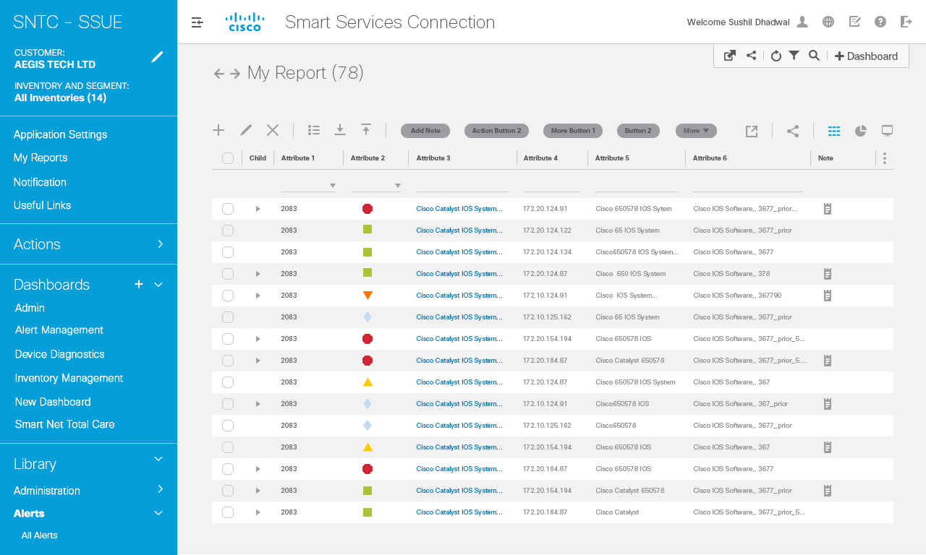
Interaction Notes
Default data grid – no items in data
Grid has been selected.
In this scenario, the Dashboard contains only 1 dashlet My Report.
Actions row toolbar: Display
Only actions that are based on
Backend capabilities.
Varies based status of selection
Of items in data grid --‐ which
Is whether it’s 1) no item is selected,
2) One item selected,
3) Multiple item selected or
4) All items selected)
By default, only display actions
That apply to status of ‘No items
selected’ on the data grid.
- Display up to 4 individual action
buttons.
- First 3 are icons representing
basic functionalities, 4th is button.
- If more than 4 actions, display a
‘More’ dropdown that provides
The rest of actions in dropdown
menu
- Upon clicking any action button,
Appropriate action should be
Invoked.
More button: Only display if number of
Actions that apply to data grid are > 4.
1
40px
1
1
2

Slide 6
Interaction Notes
Global Components of Smart Report:
Mission control menu. Always persistent at the page level.
Actions toolbar.
Dashlet title and count (if applicable)
Navigation History.
Dashlet level controls/views: Export, Share, grid, chart and billboard views.
Grid menu: Provides the functionality to Unhide the hidden columns.
Child column header
Child dropdown button: Upon clicking, displays tree map of child/grandchild rows.
Go to next screen for details.
1
3
4
1
5
6
2
2
3
7
4
5
6
8
7
8

Slide 7
Contextual Menu
Add Column

Slide 8

Interaction Notes
1
Contextual menu is available on each
Column header on hover. Clicking on
Which opens popup with below items.
Contextual menu contains:
• Add Column
• Ascending/Descending sort
• Hide Column.
As per UI grid functionality.
• Pin Right – Freezes column so only
Columns to right can be scrollable. As
Per UI grid functionality
• Pin Led – As per UI grid functionality
1

Slide 9
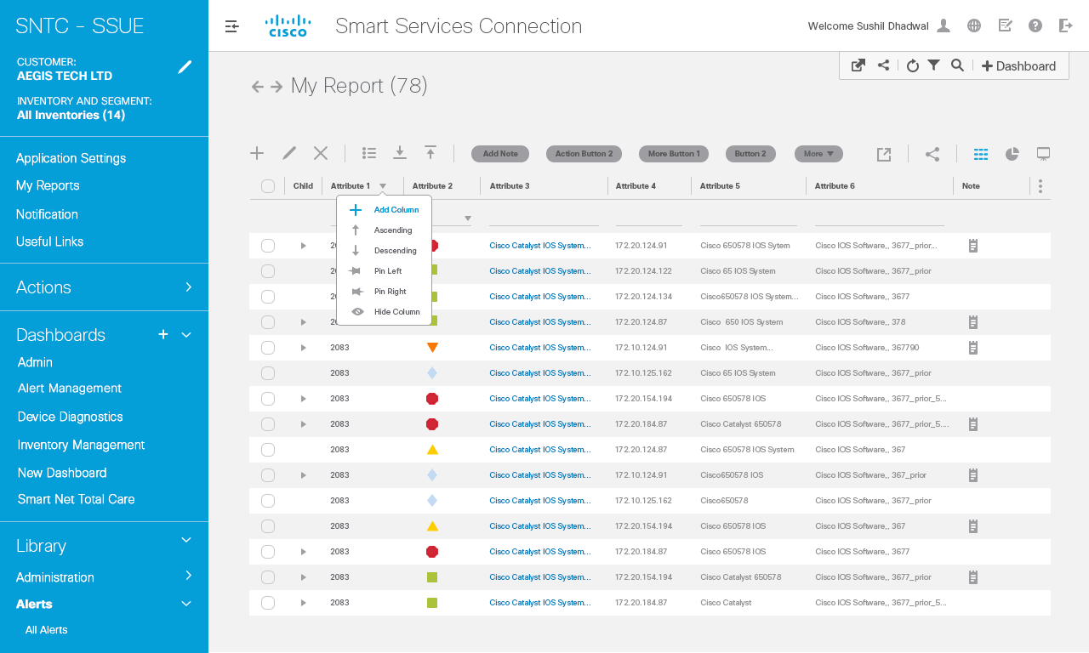
Interaction Notes
User can check the hidden column list and it will get unhide. This New unhide Column will get added to the right of the Column in which the Add Column action Was invoked. Refer the next slide to see how it gets added to the grid.
Ordering of fly out menu is:
List of hidden columns in alphabetical order.
Followed by list of visible columns displayed in same way as in data grid
1
1

Slide 10
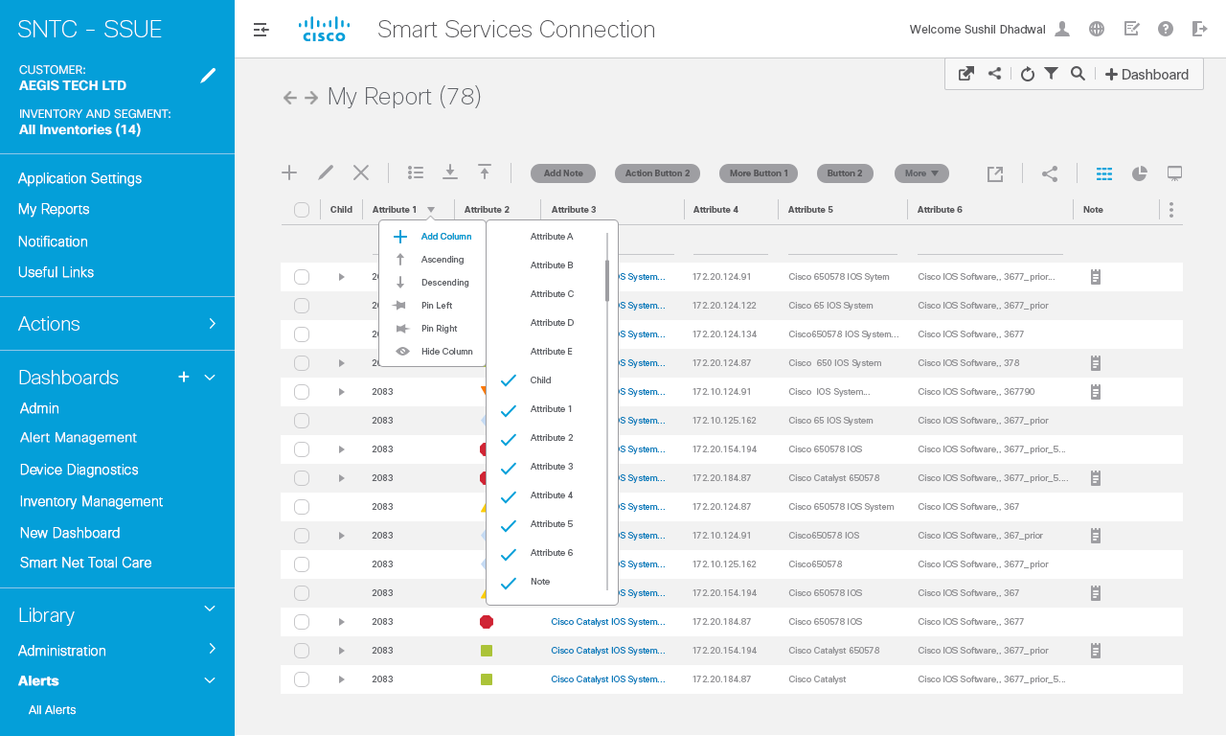
Interaction Notes
Click add column, flyout comes and user can select which column to add.
1
1

Slide 11

Interaction Notes
1
Hidden column selected.
1

Slide 12
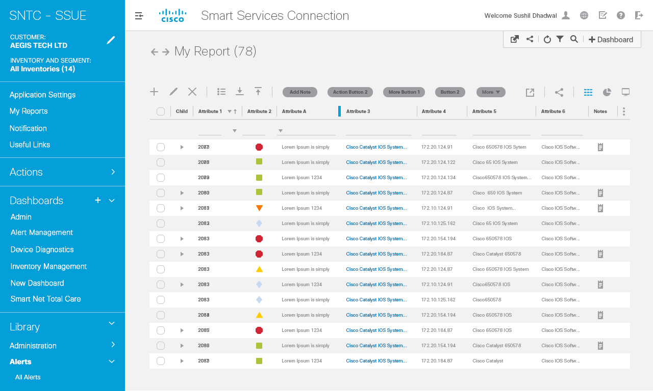
Interaction Notes
1
Selected column is added to grid .
1

Slide 13
Contextual Menu
Sorting: Ascending

Slide 14
Interaction Notes
1
Contextual menu is opened.
User clicks on sorting by ascending and
Item in the column gets sorted by the
Ascending value.
Refer next slide for the interaction.
1

Slide 15
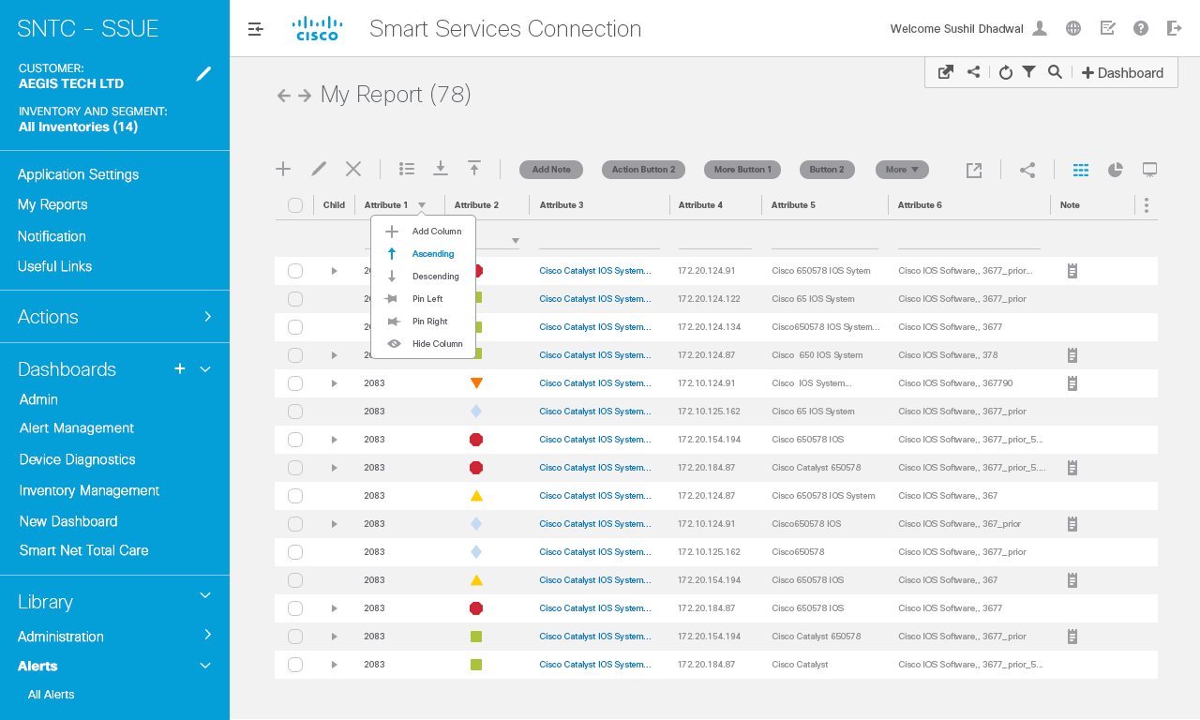
1

Slide 16

1

Slide 17

1

Slide 18
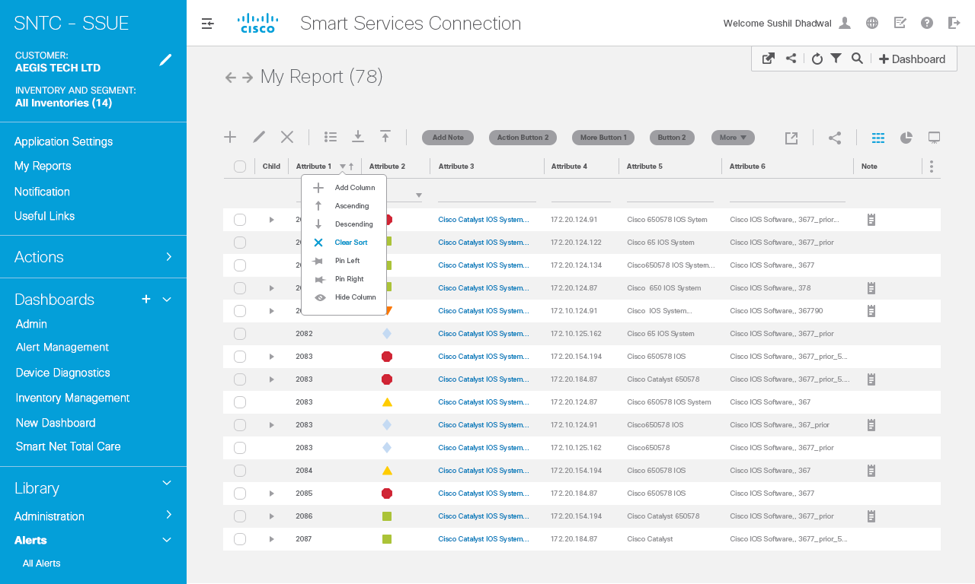
Interaction Notes
Contextual menu is opened.
Clear Sort is an action now since user
has sorted column already.
1
1

Slide 20
Export

Slide 21

Interaction Notes
1
Export Menu – No individual rows
selected
1

Slide 22
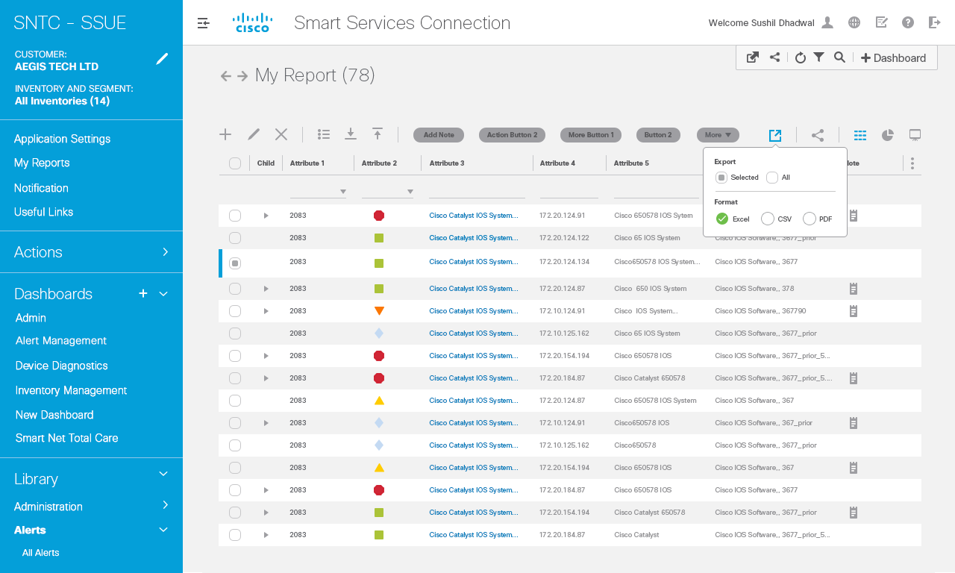
Interaction Notes
Export Menu: Export entire
Data grid
Export menu dropdown: Content varies depending on
If user has selected individual
Data grid items/rows
If no row’s been selected the
Entire data grid will be exported upon selecting an
Export option. Also, a descriptive note is provided
To indicate entire row will be
exported.
By default, no export format
Will be selected.
Export format options: Once
clicked, dropdown menu closes
And data is exported as per
Export selection.
Upon clicking checkbox next to
One or more rows, only those
“checked” rows will be exported when clicking on an
Export option (e.g. Excel, CSV,
PDF)
08/03--‐Need to provide
Scenarios for 1) if exporting all
(none selected and none
filtered) 2) all exported, only
filtered, 3) all exported, only
filtered, selected items.
1
1
2
2

Slide 23
Share

Slide 24
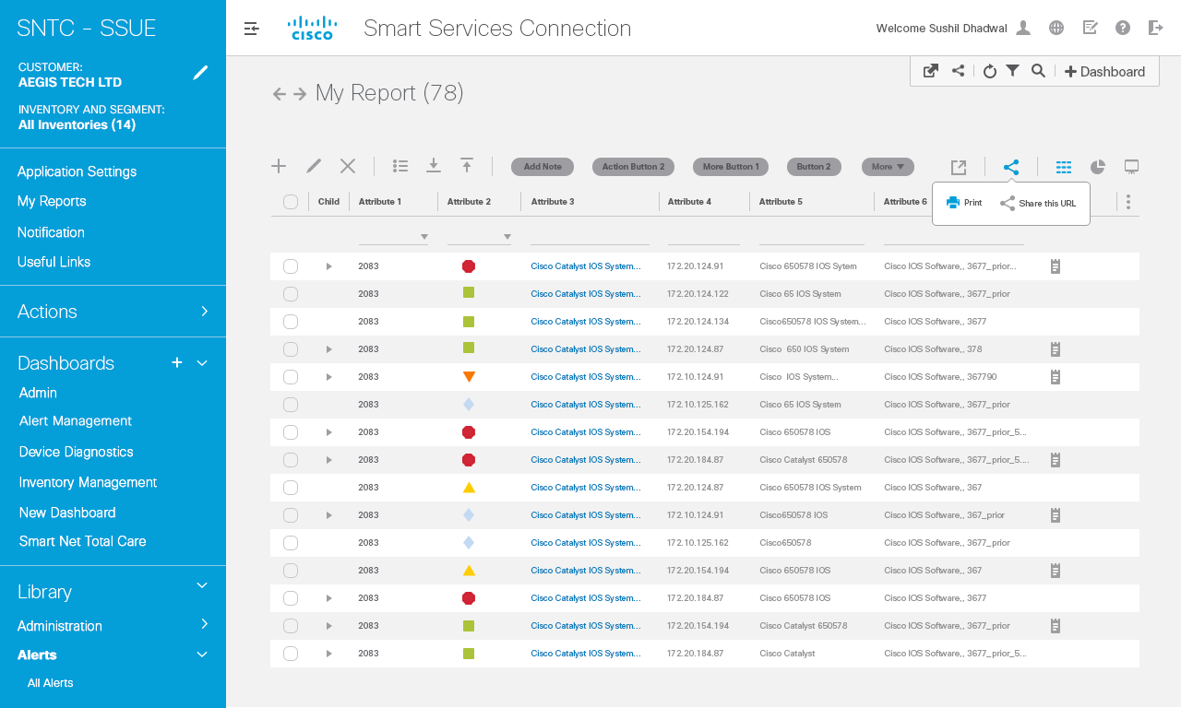
Interaction Notes
Print and Share this URL functionality
Print action will open a Print
Dialog box as per existing
functionality.
Share this URL button:
Upon click, will provide
A confirmation message which
Will fade out automatically ader 3 secs or user can close it
By clicking on cross icon Add
Please see next slides for interactions
1
2
1
2

Slide 25


Slide 26
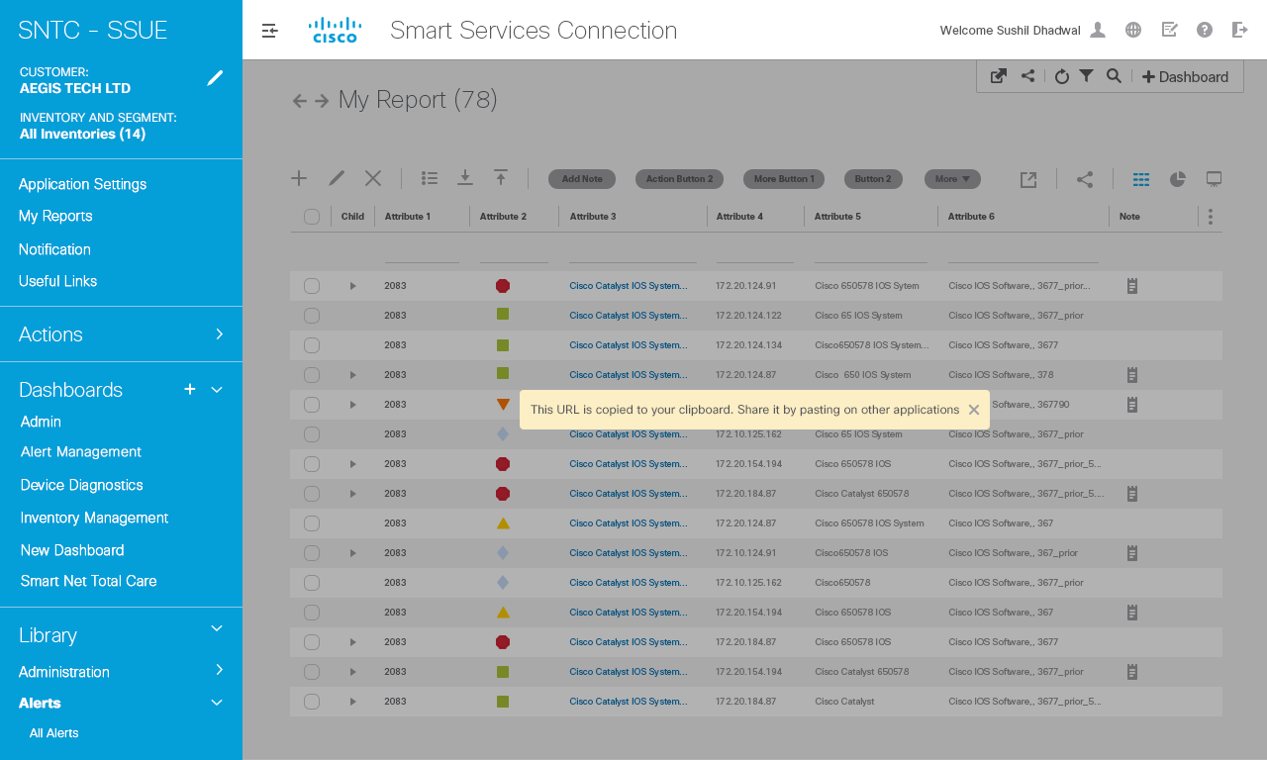

Slide 27
Attribute Charting

Slide 28
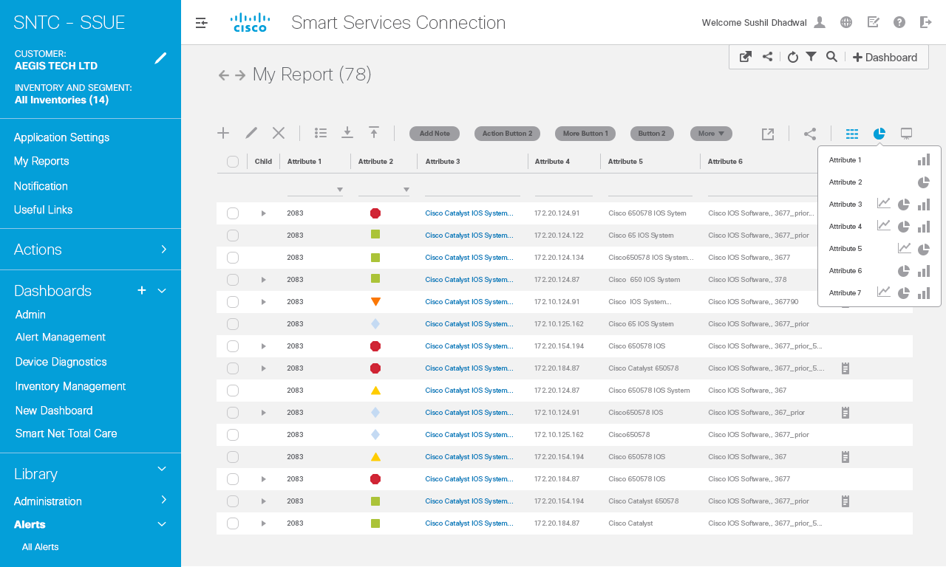
Interaction Notes
1
The chart option becomes
Enabled and upon click, provides a list of chart options.
In terms of complex visualizations, the app designer Can customize the set of Attributes
1

Slide 29
Grid Menu

Slide 30
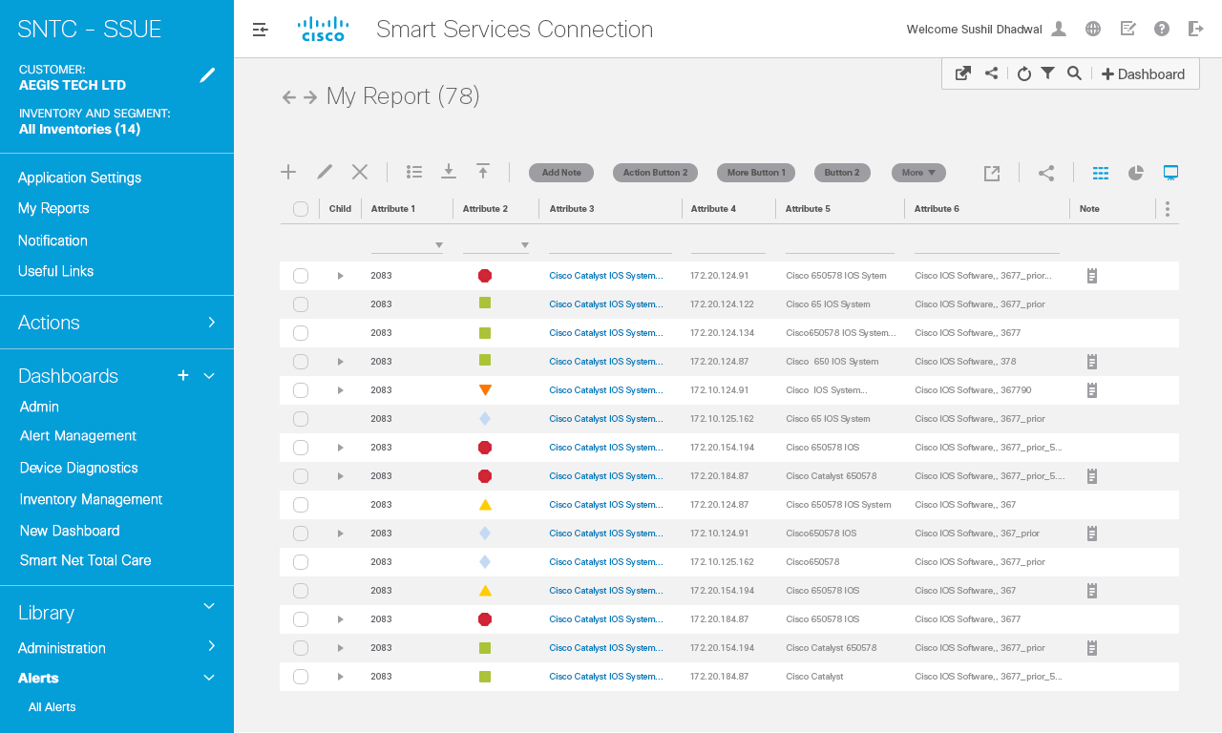
Interaction Notes
1
Grid menu provides the functionality to
Unhide the hidden columns.
This is As per UI grid functionality.
Go to next screen for details.
1

Slide 31
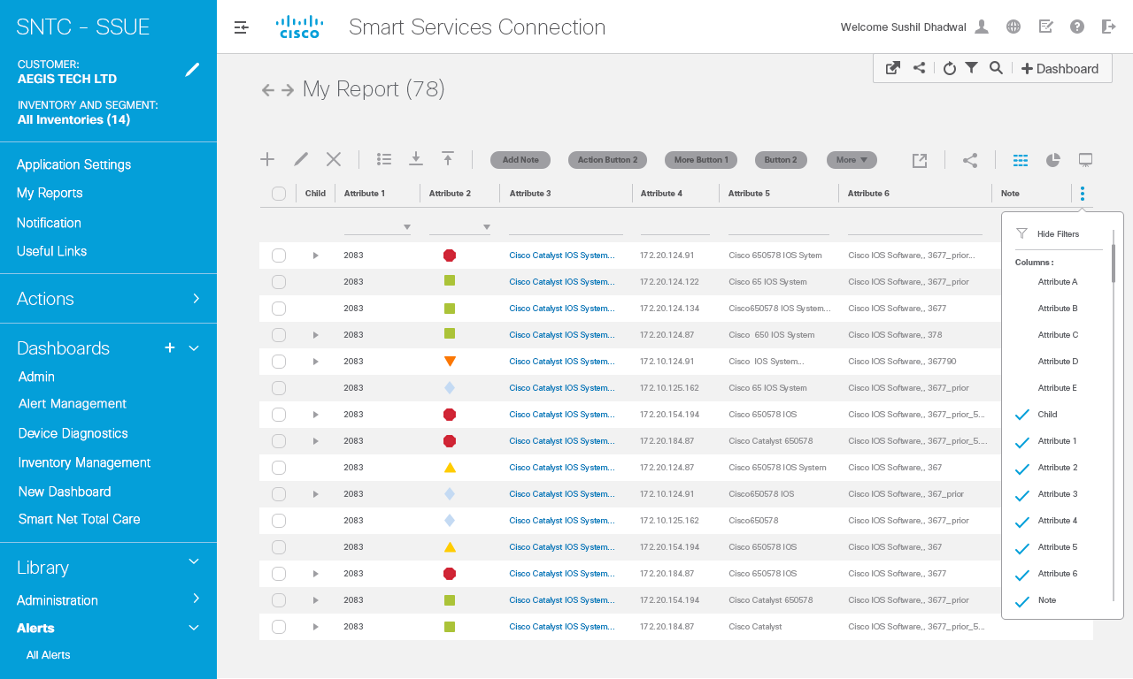

Interaction Notes
1
Show/hide filters
For step by step interactions please refer the next steps.
1

Slide 32
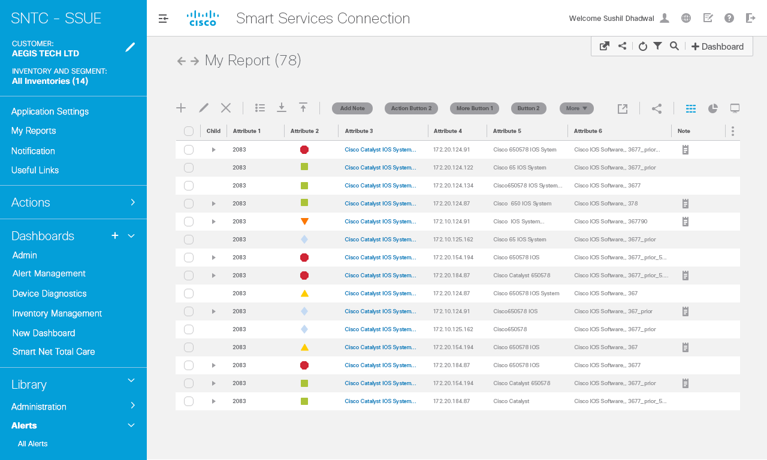
Interaction Notes
1
Show/hide Columns checkboxes: This is As per UI grid functionality.

Slide 33
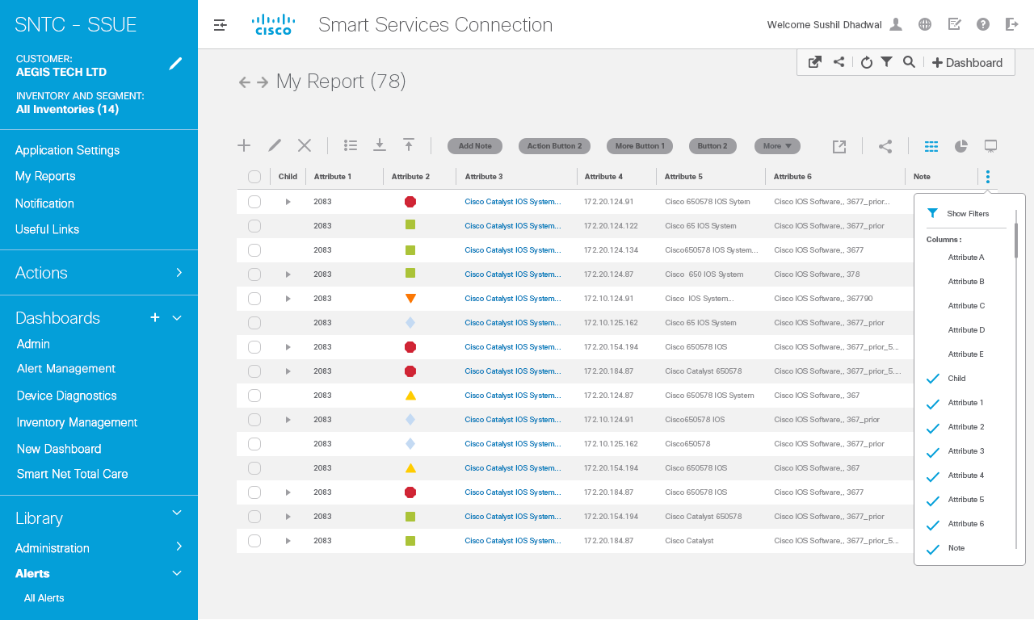
1

Slide 35
Tool Tip

Slide 36
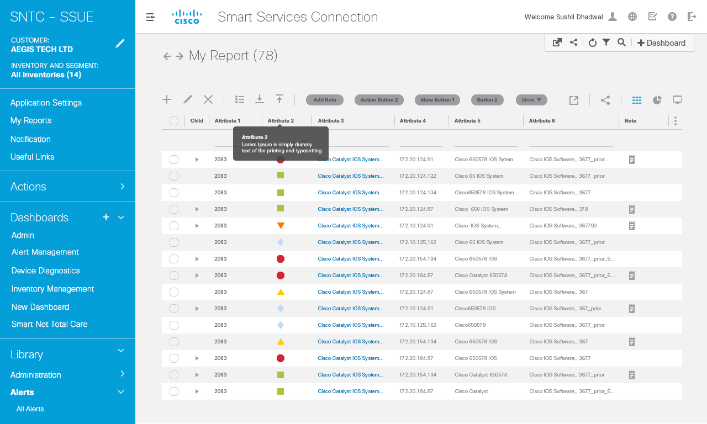
Interaction Notes
1
On hover over the column title small description will be shown to explain the attribute and what it means.
1

Slide 37
Notes

Slide 38
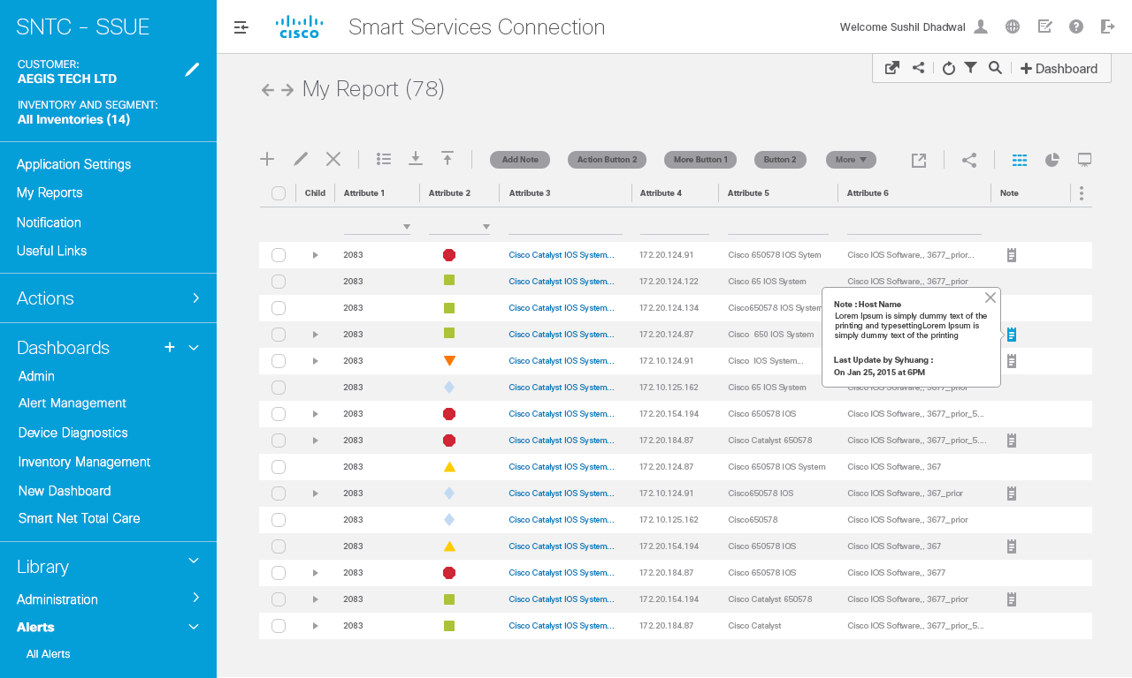
Interaction Notes
1
Provide Note icon, which when in focus, displays the details of the note.
Note icon: Upon hover, opens up a popup with details about the note.
2
1
2

Slide 39
Add Row

Slide 40

Interaction Notes
Interaction Notes
1
1

Slide 41
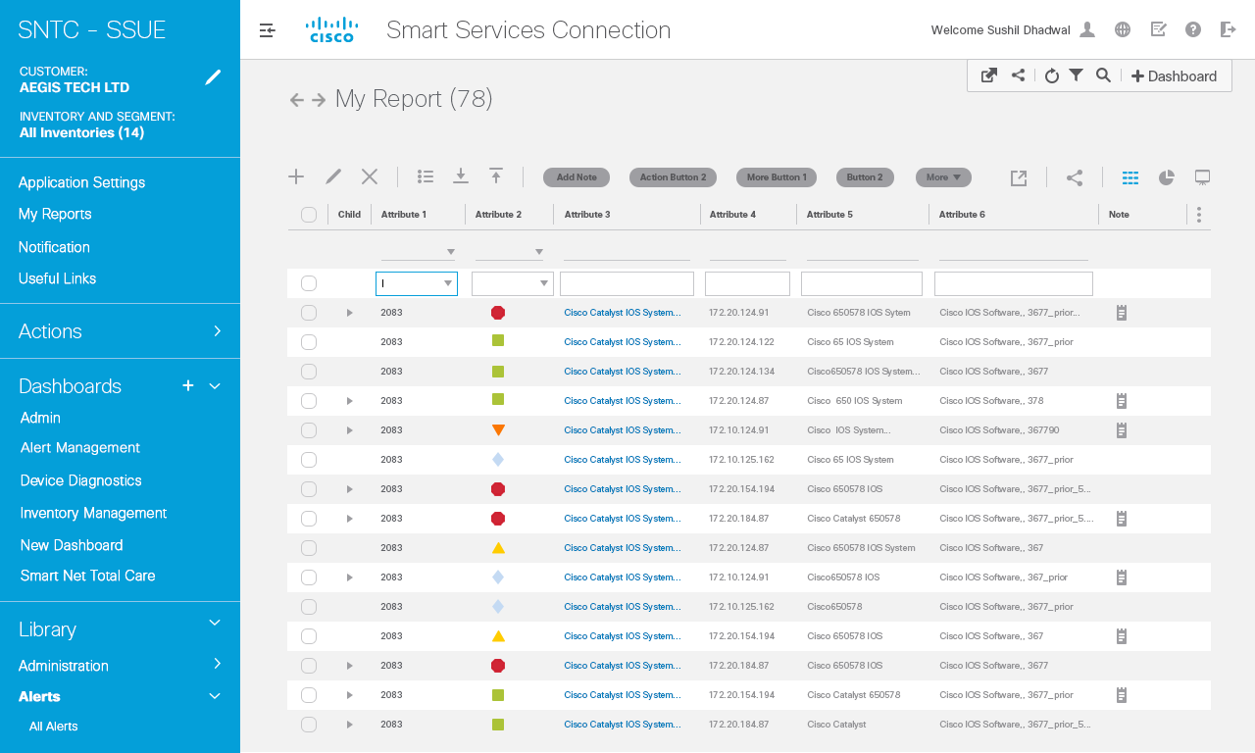
Interaction Notes
Interaction Notes
1

Slide 42
Add Child Row

Slide 43
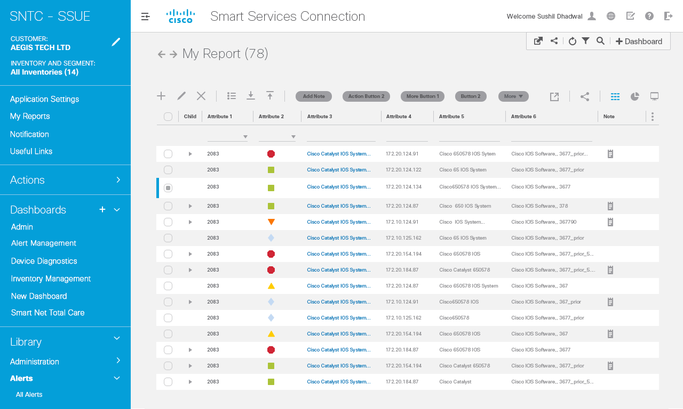
Interaction Notes
Interaction Notes
1
Default state of a complex grid in which
row has to be added.
Row selected
1

Slide 44

Interaction Notes
Interaction Notes
1
Click on the + icon to add row
Row selected
1

Slide 45
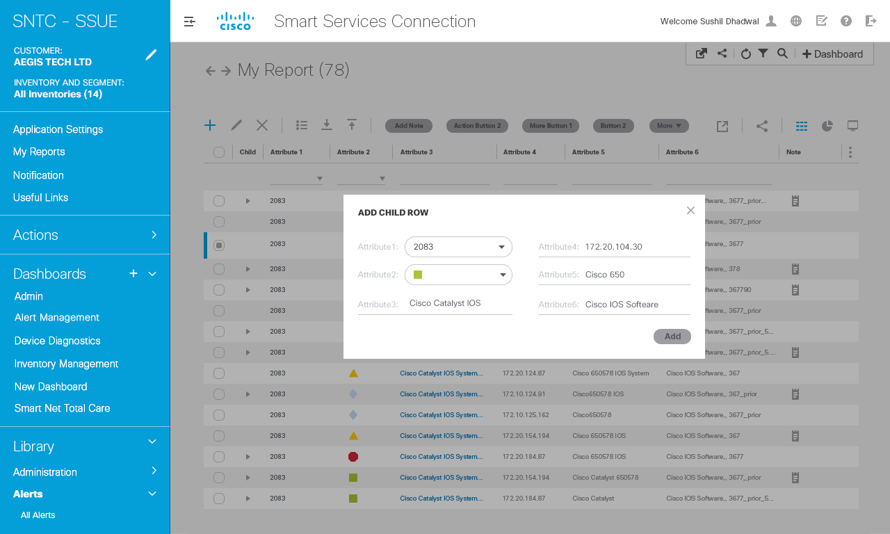
Interaction Notes
Interaction Notes
1
Pop up with attributes and input fields
come up.
1

Slide 46
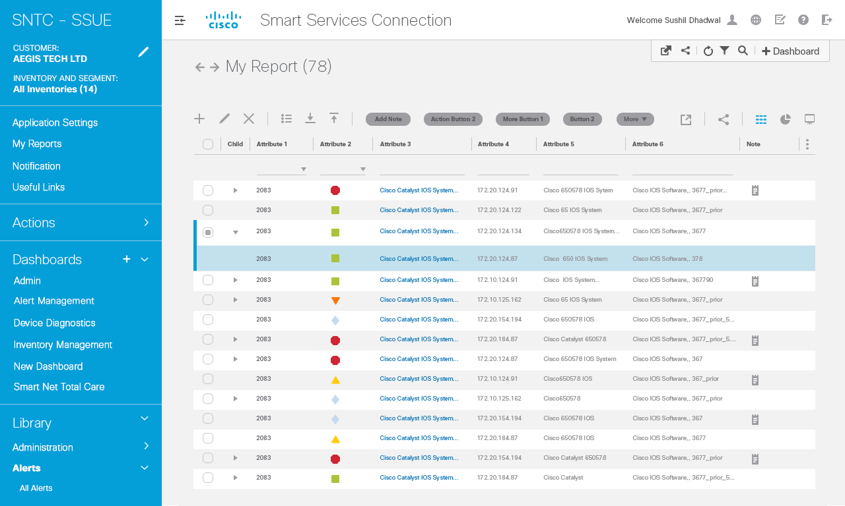
Interaction Notes
Interaction Notes
1
Child row is added to the parent row selected
1

Slide 47
Edit Row

Slide 48

Interaction Notes
Interaction Notes
1
Row to be edited is selected and then clicked on the pencil icon
1

Slide 49

Interaction Notes
Interaction Notes
1
Pop up with all the attributes come in editable format and row entries can be edited.
1

Slide 50
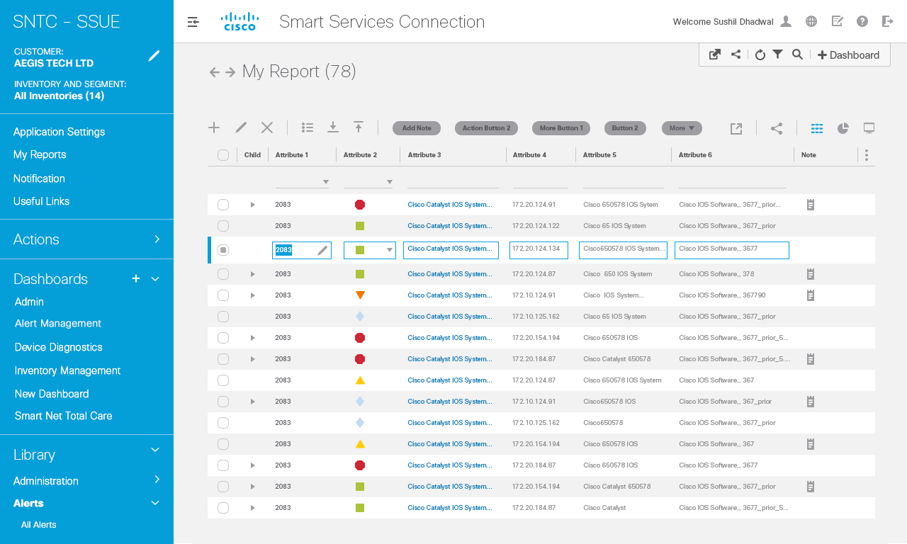
Interaction Notes
Interaction Notes
1
In case data grid is not complex and no columns are hidden, then inline editing can also be suggested where clicking on pencil icon will invoke editable format inline to be edited as per the need.
1

Slide 51

Interaction Notes
Interaction Notes
1
Edit save confirmation comes along with an option to undo and close the message button.
1

Slide 52
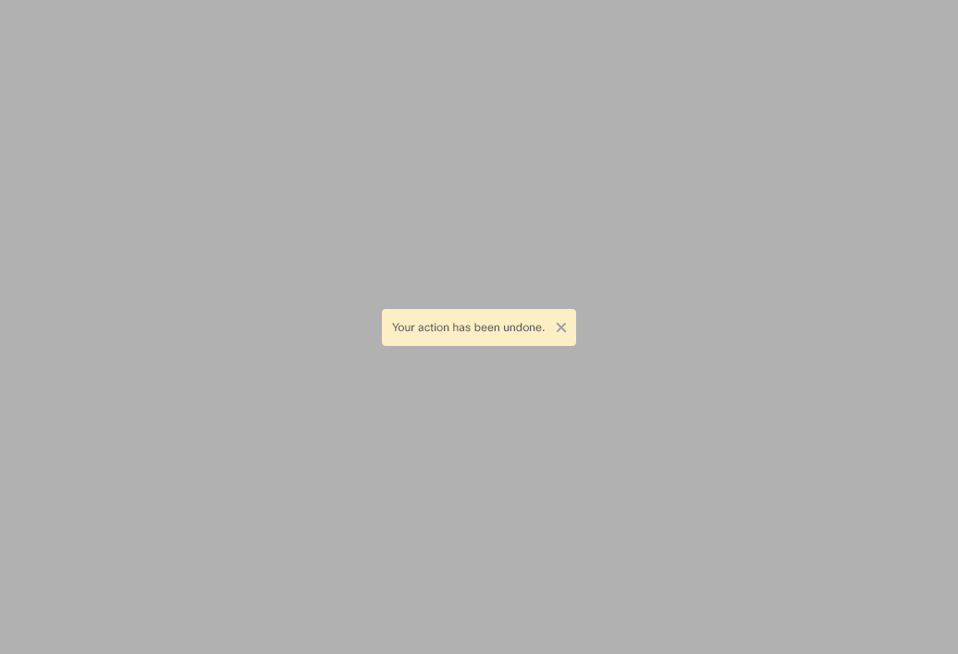
Interaction Notes
Interaction Notes
1
Clicking on undo button will revoke the changes.
1

Slide 53
Edit Cell

Slide 54
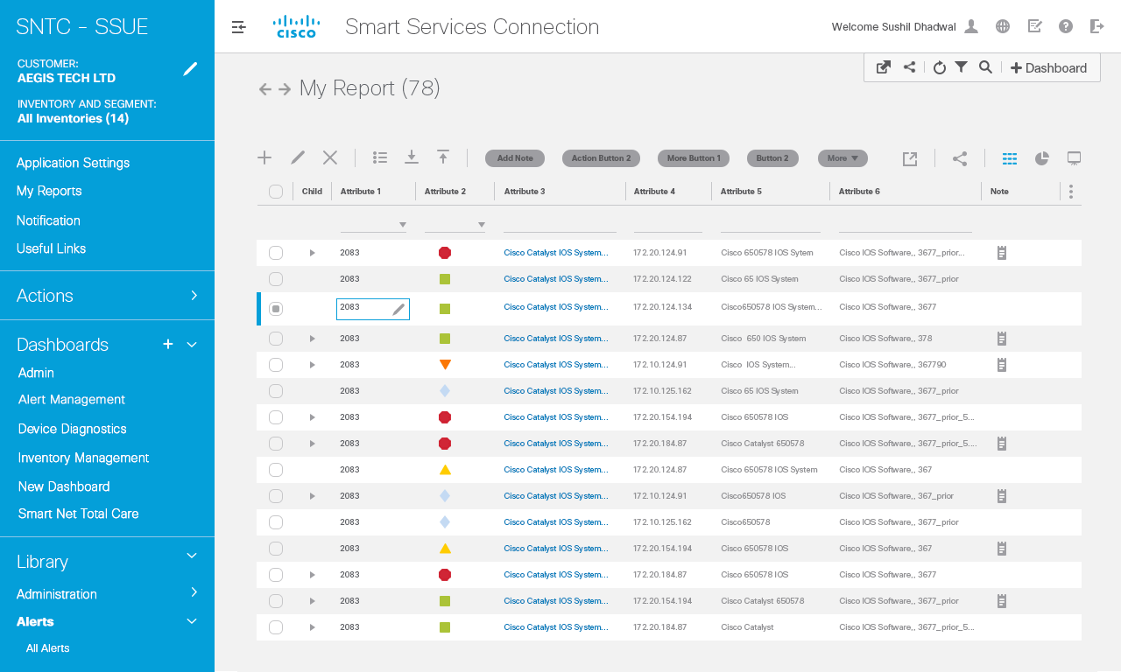
Interaction Notes
Interaction Notes
Upon hover, edit icon is displayed
For data cell that’s editable.
Edit icon: Upon Clicking the Edit
icon, content in data cell is
highlighted. See next slide for
interaction.
1
1

Slide 55
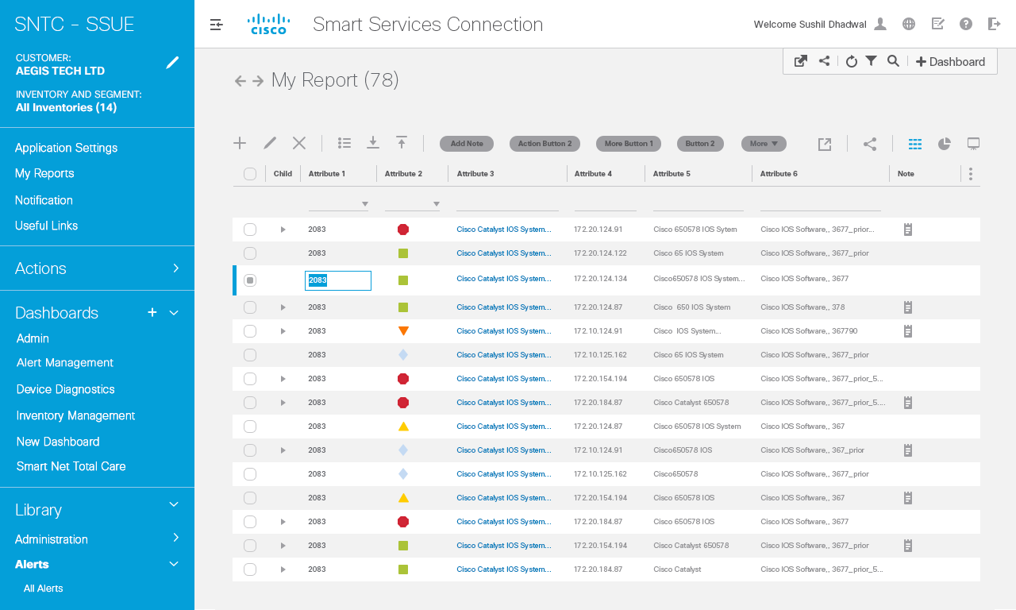
1

Slide 56

Interaction Notes
Interaction Notes
User has cleared content inside
Data cell and can type in new content and click outside the cell to save the changes.
1
1

Slide 57
Delete Row

Slide 58

Interaction Notes
Interaction Notes
Similar interaction pattern used as add, edit row.
User can select the row to delete and click on X on toolbar and row will be deleted.
See next slides for the flow.
1

Slide 59
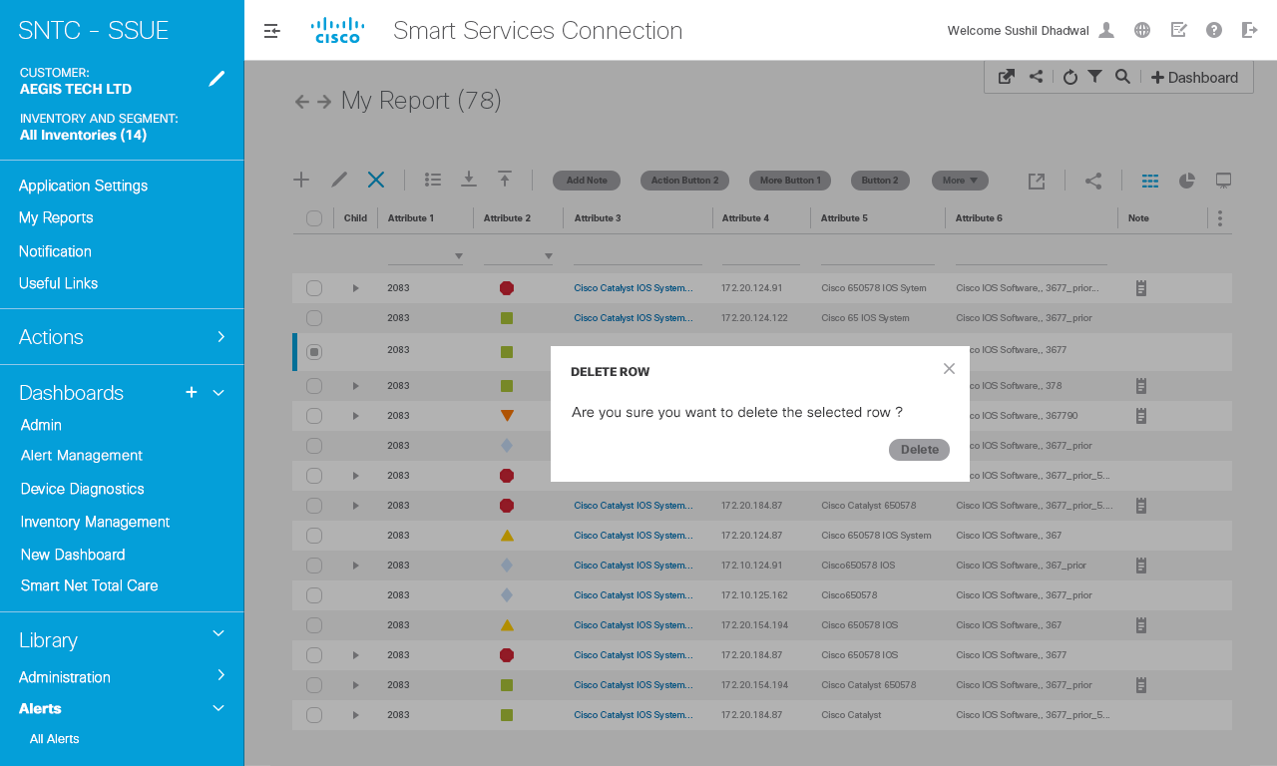
Interaction Notes
Interaction Notes
1
Confirmation pop up
1

Slide 60
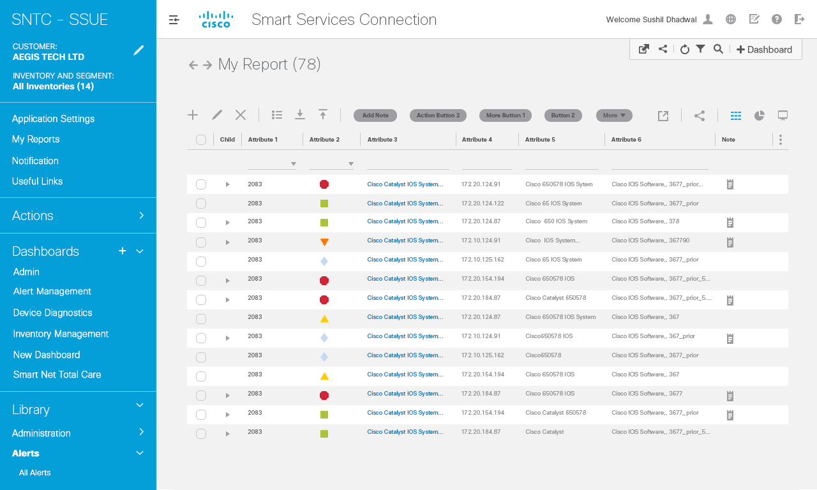
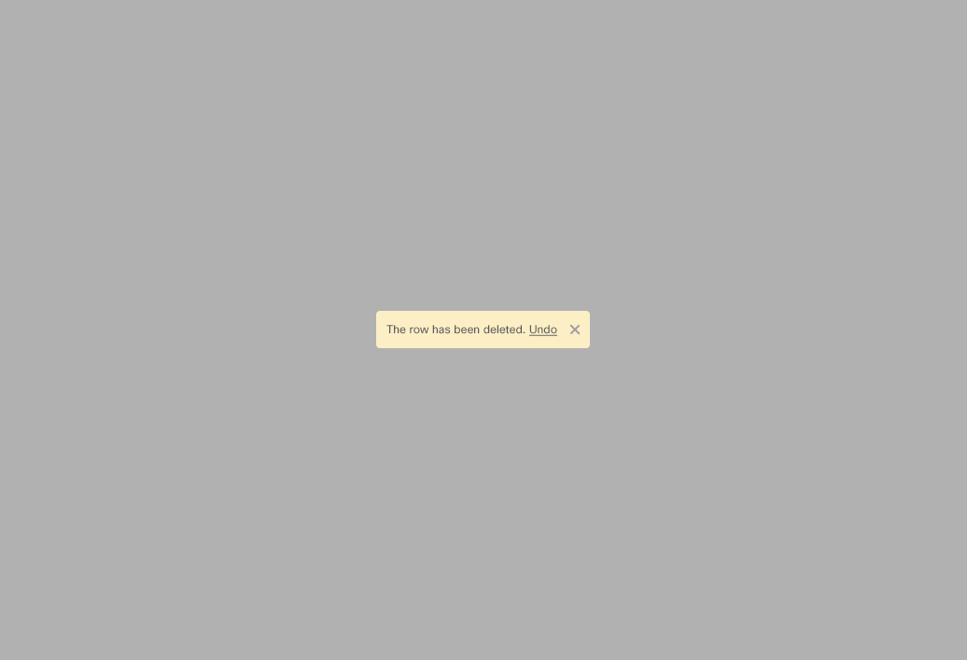
Interaction Notes
Interaction Notes
1
Info Message along with option to undo the change. If selected then go to next slide.
1

Slide 61
1

Slide 62
Expand Column

Slide 63
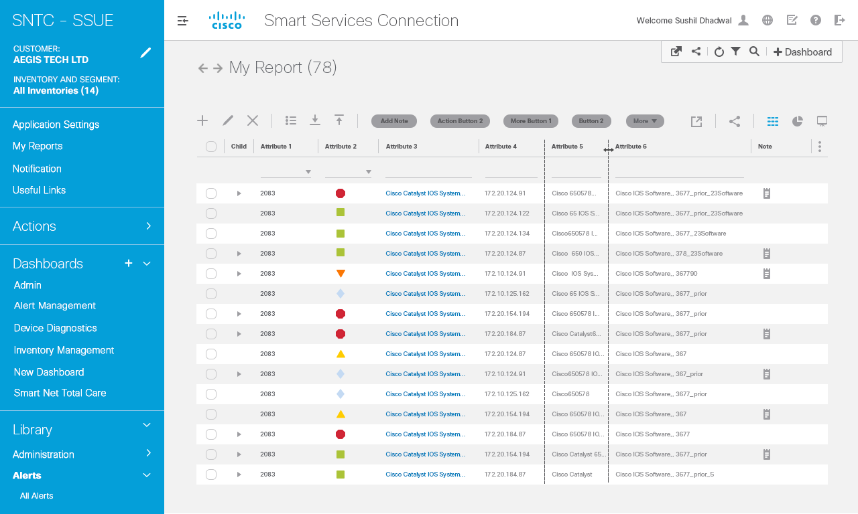
Interaction Notes
Interaction Notes
1
Upon hovering over border line of a
column, the resize icon is displayed to Indicate resize of column.
Same functionality as per excel.
1

Slide 64

Interaction Notes
Interaction Notes
1
Dragging behavior displays lines around Column that’s to be resized.
1

Slide 65

Interaction Notes
Interaction Notes
1
Dragging behavior displays lines around Column that’s to be resized.
1

Slide 66
Quick Filters
Text input
Data Range
Status
Numeric
Fixed Text Value

Slide 67
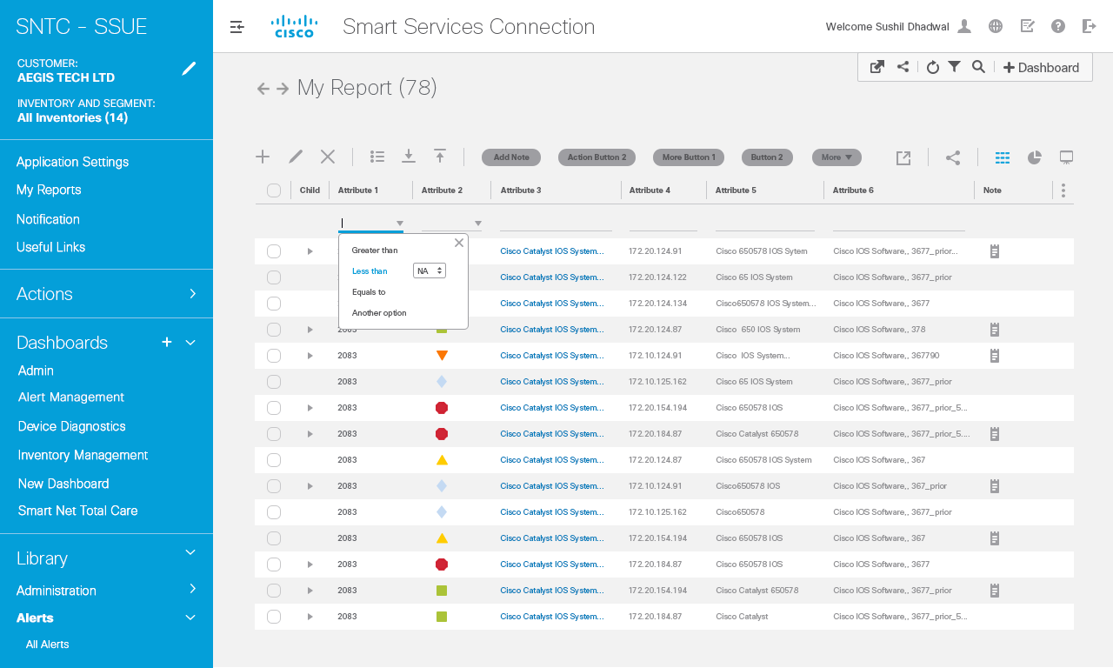
Interaction Notes
1
Default data grid – no items
In data grid has been selected.
Quick filter search:
Depending on attribute nature, display appropriate filter control (ie. Basic text box, dropdown menu, date picker etc.). See next slide for specifications.
Need to come up with distinction in terms of to what level we want to provide filtering capabilities in quick filter.
Keep basic filtering at quick filter level and more advanced in advanced filter level.
In page level, show pillars for the filters. How do we show advanced filter criteria in the filter pillar?
1

Slide 68

Interaction Notes
1
Range filter
1

Slide 69
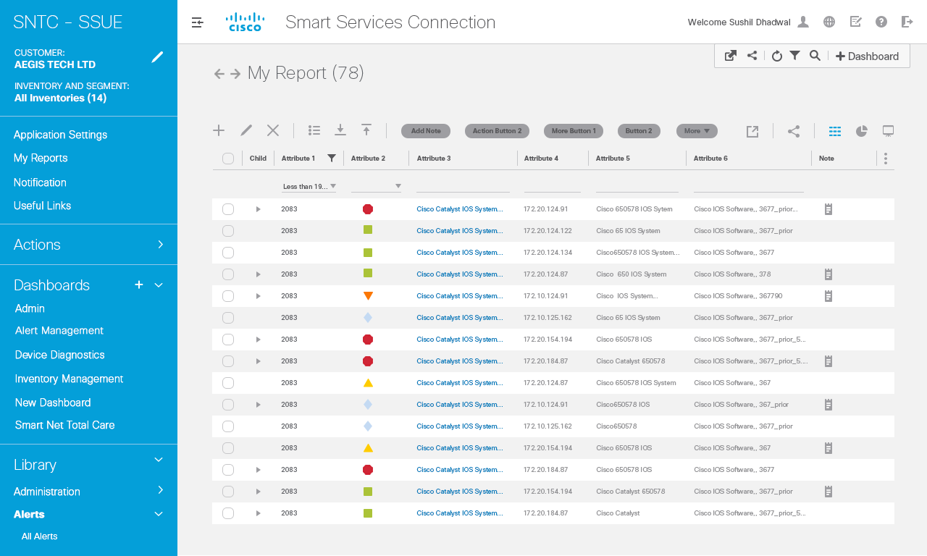
1

Slide 70
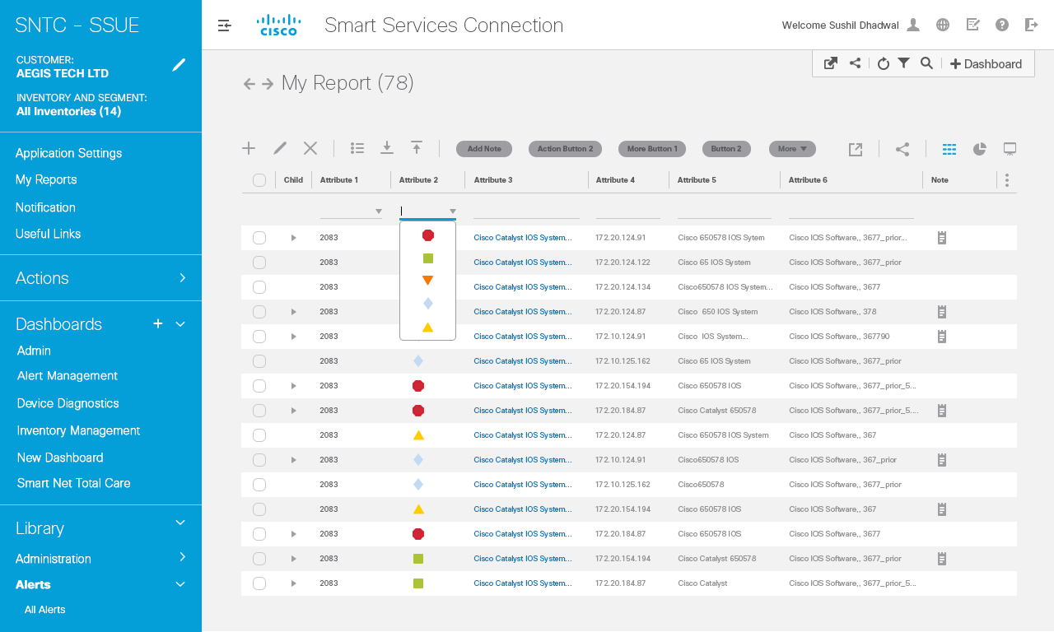
Interaction Notes
1
Status filter
1

Slide 71
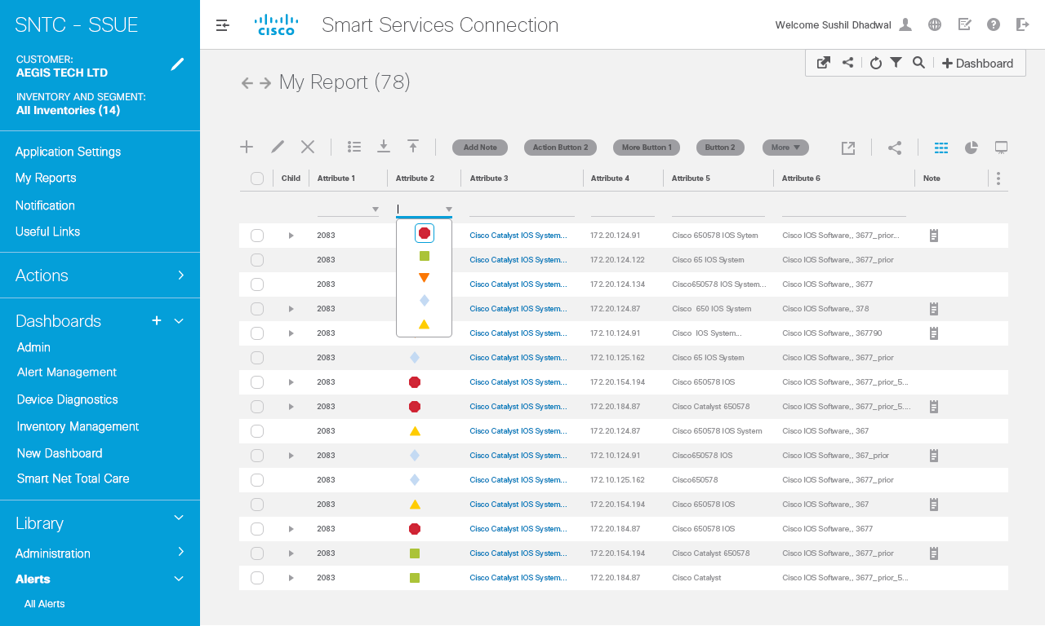
Interaction Notes
1
Status filter
1

Slide 72
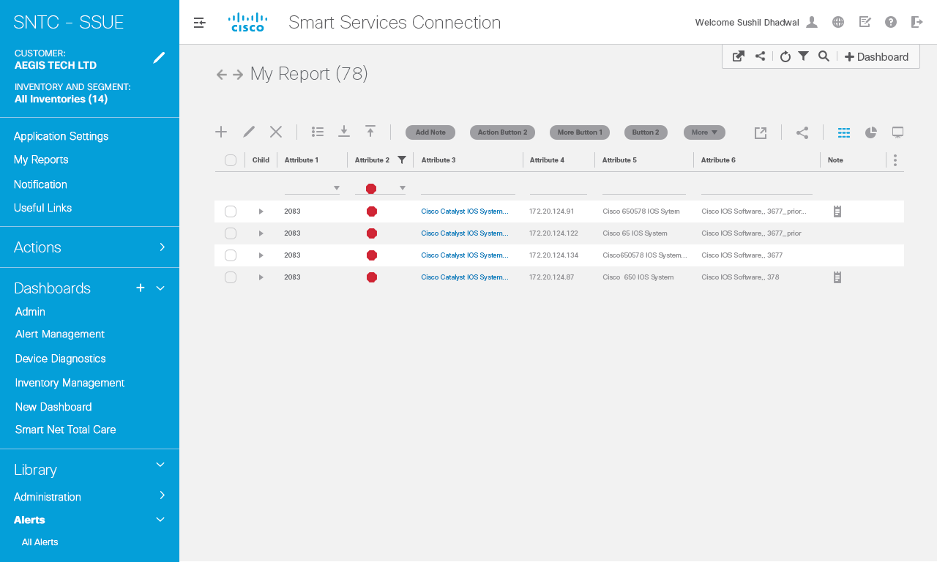
1

Slide 73
Interaction Notes
1
Filter removed

Slide 74
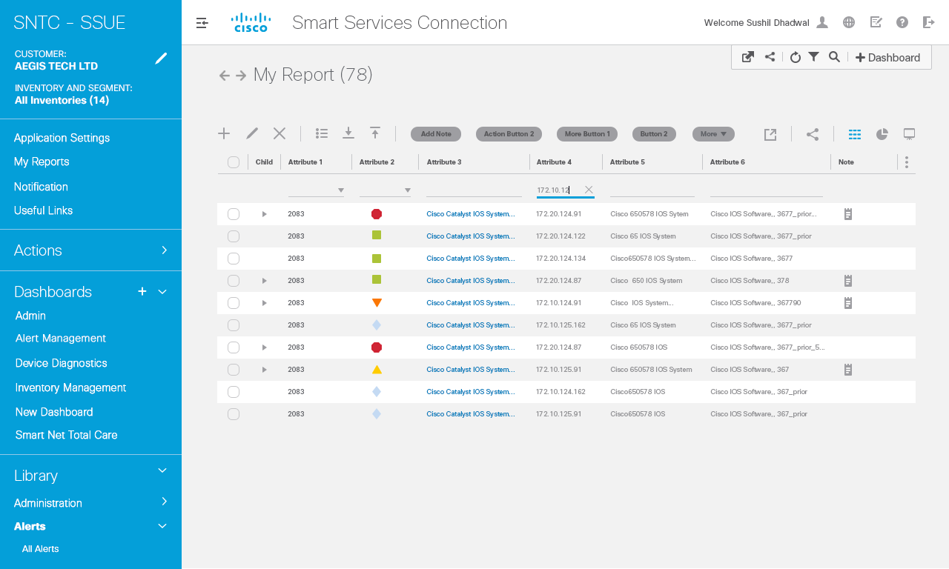
Interaction Notes
1
Numeric filter
1

Slide 75
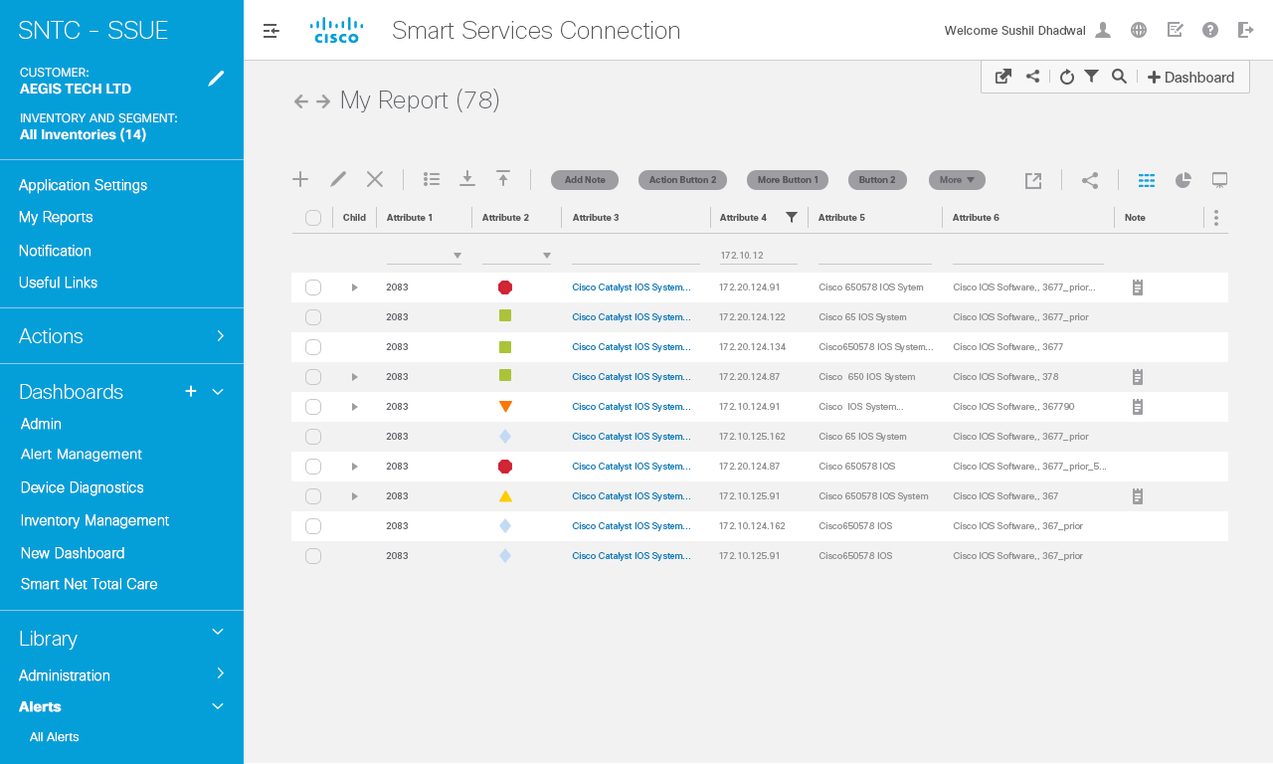
Interaction Notes
1
Filter applied
1

Slide 76
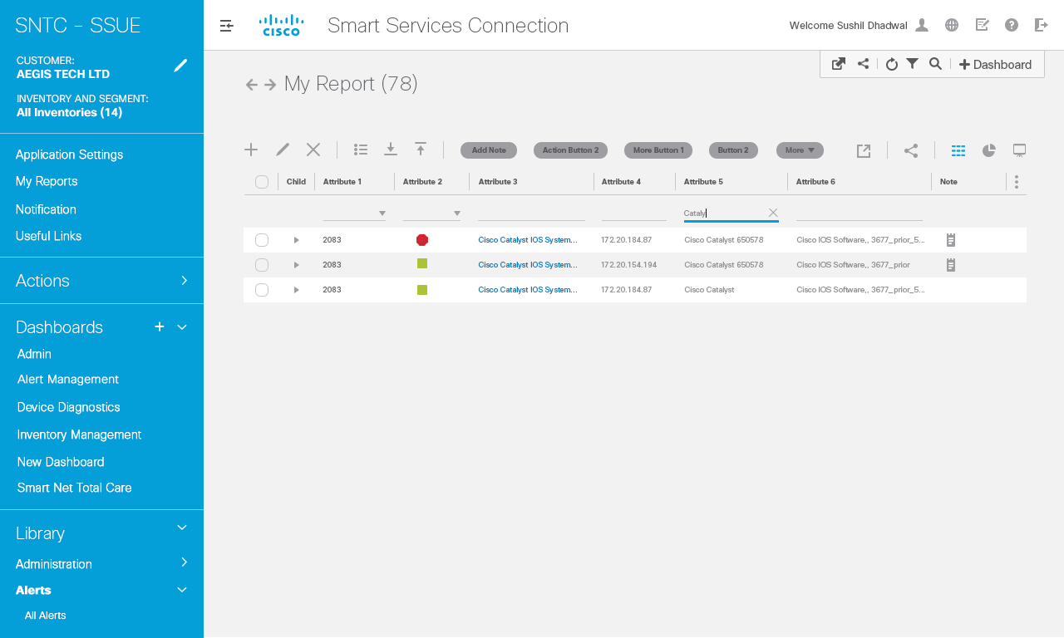
Interaction Notes
1
Text Filter (text input field)
1

Slide 77
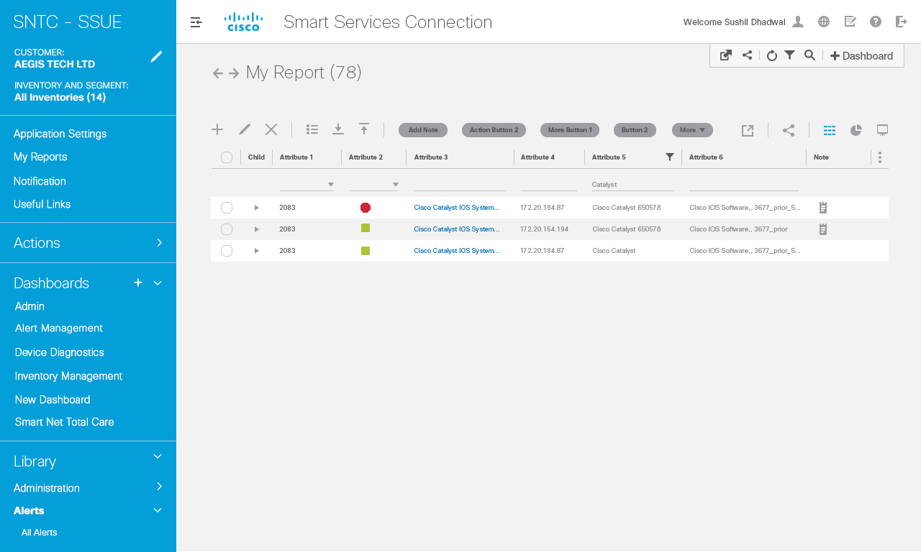
Interaction Notes
1
Text Filter applied
1

Slide 78

Interaction Notes
1
Calendar filter
1

Slide 79
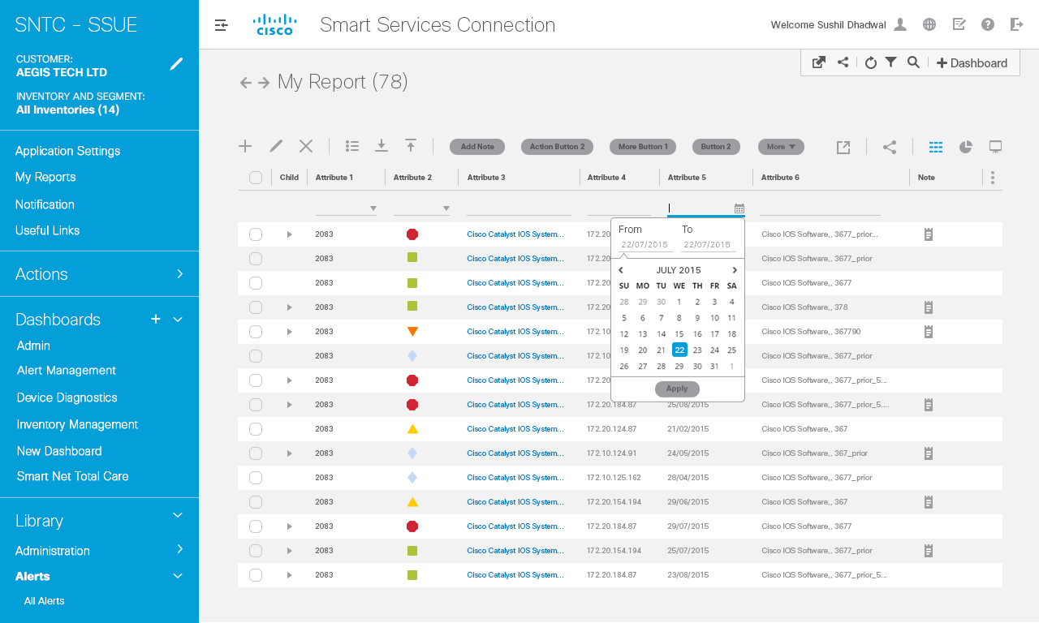

Slide 80


Slide 81
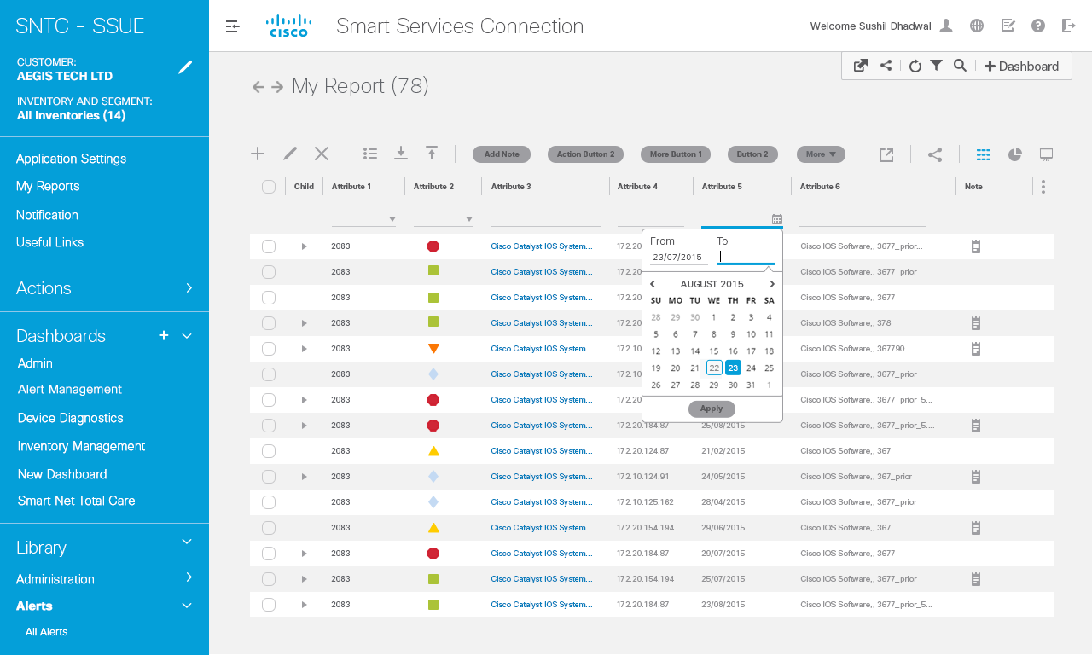

Slide 82
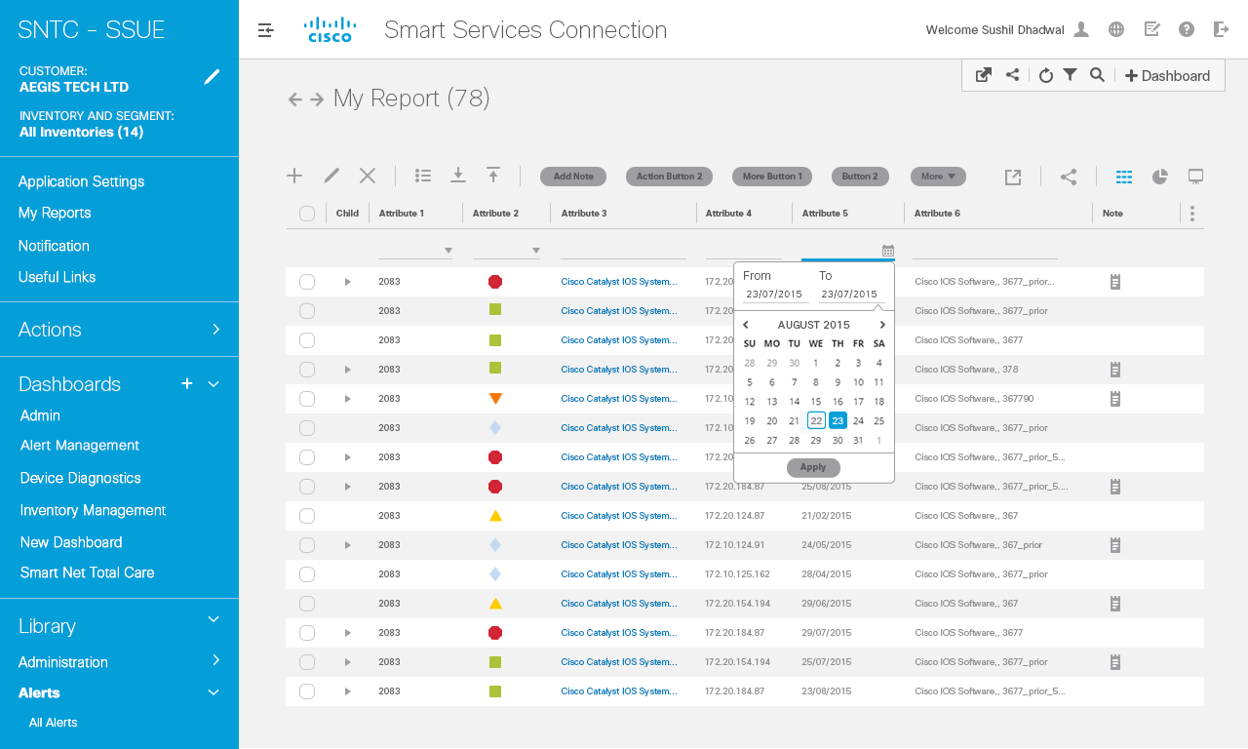

Slide 83
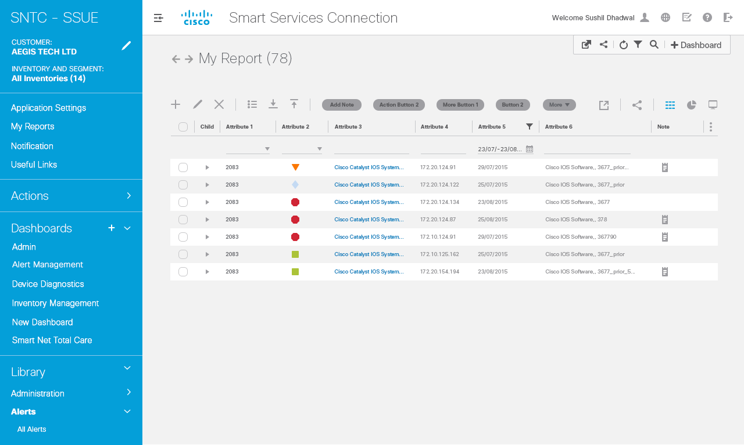

Slide 84
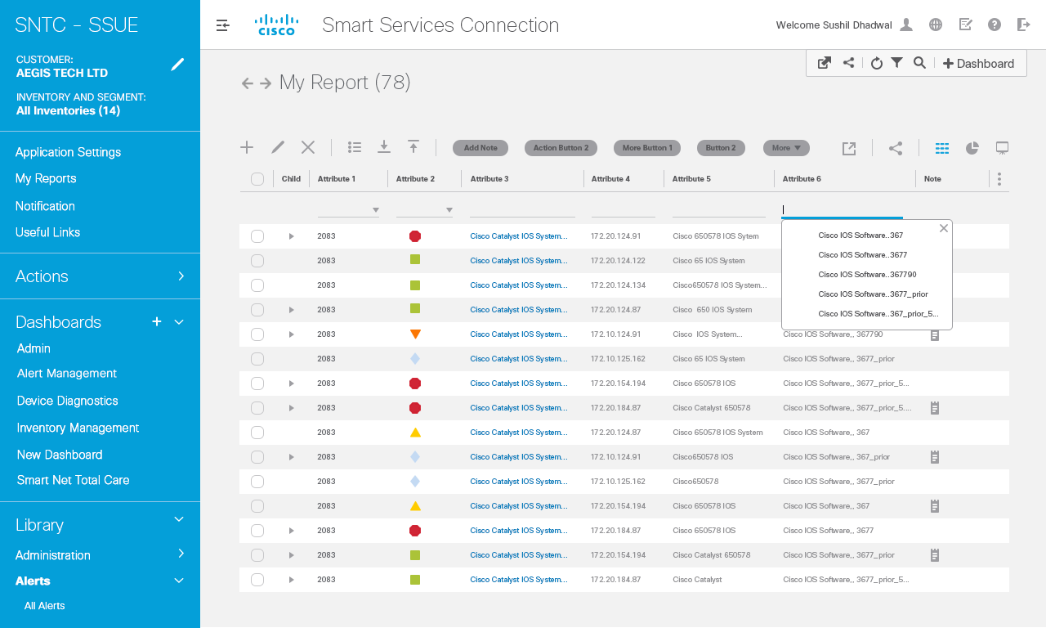

Slide 85


Slide 86
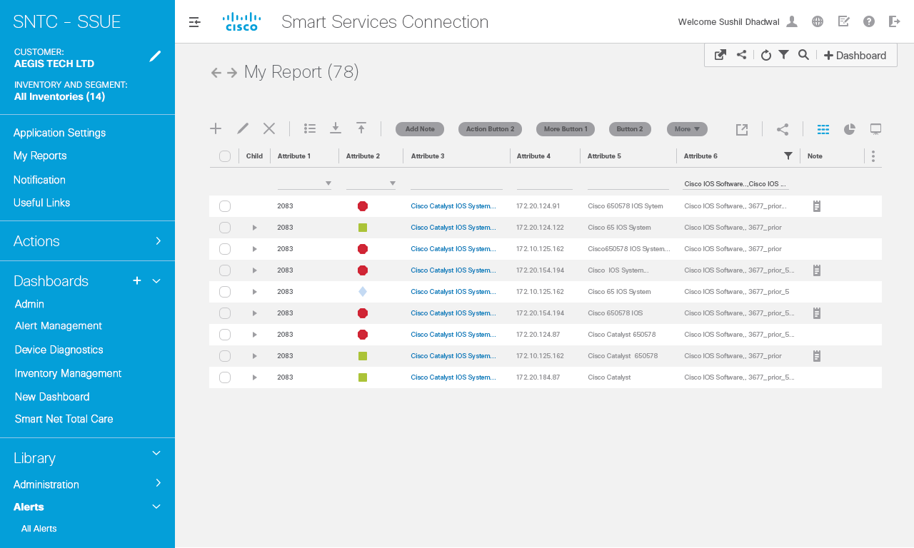

Slide 87
Details- Option1

Slide 88
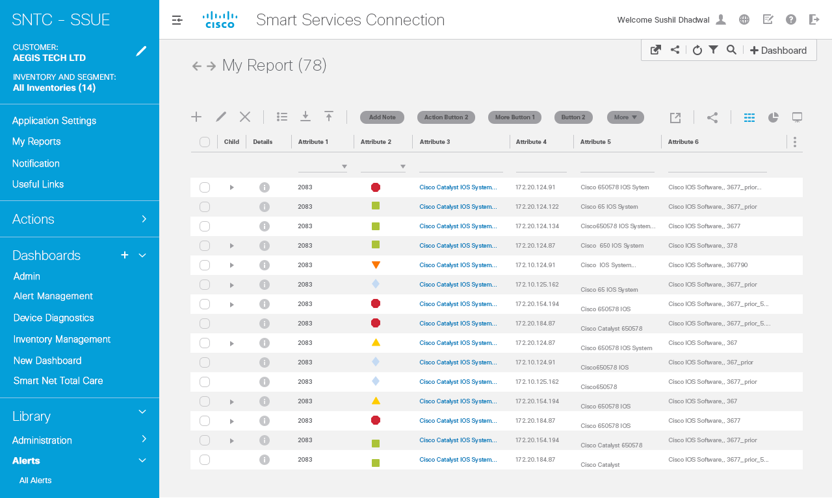

Slide 89
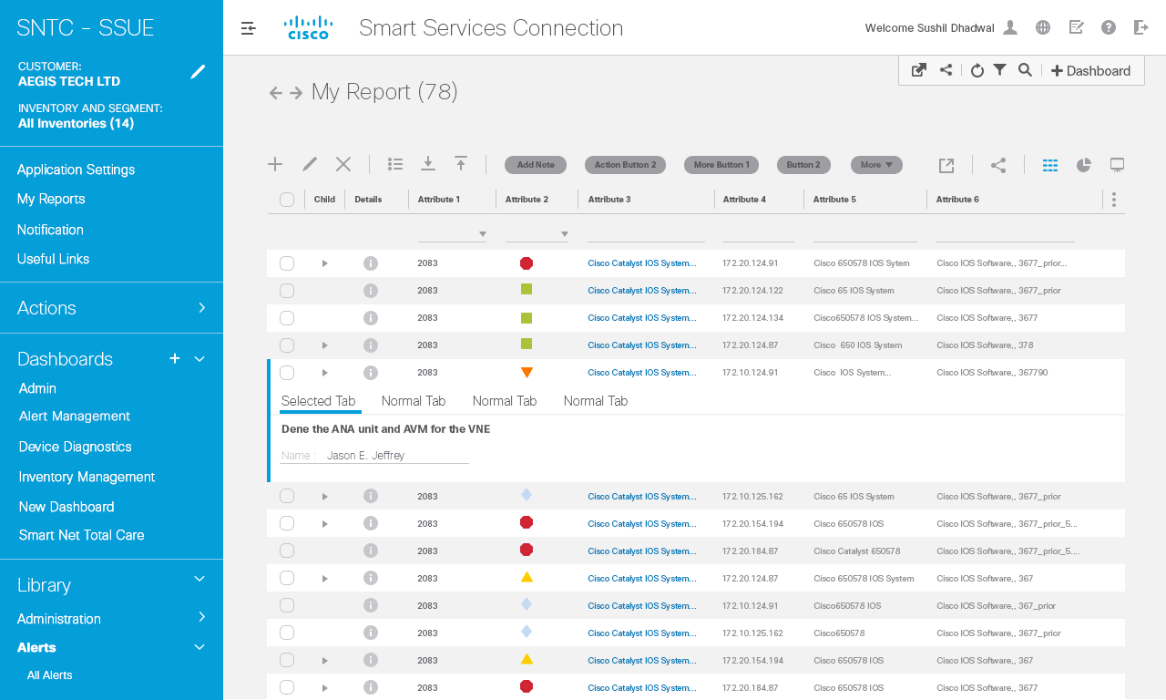

Slide 90
Details- Option2

Slide 92
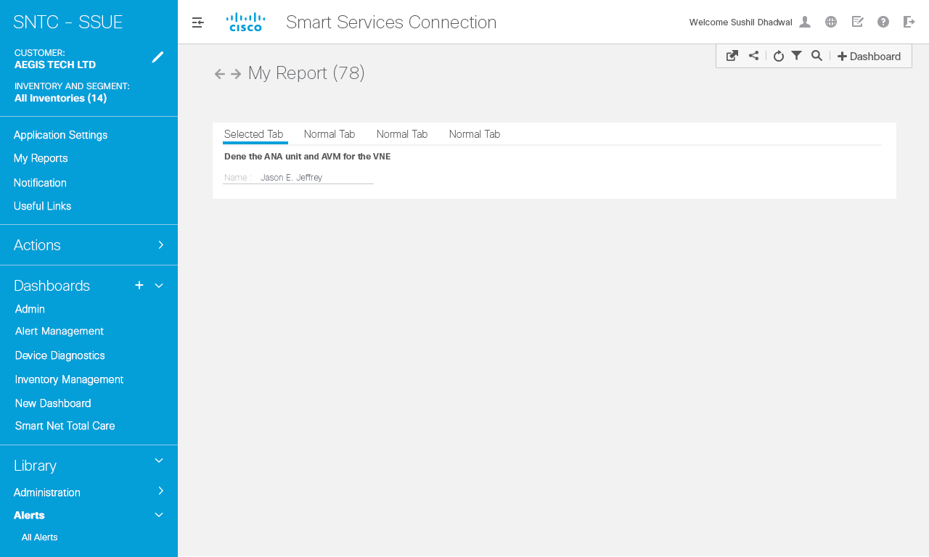

Slide 93
Parent Child Row

Slide 94
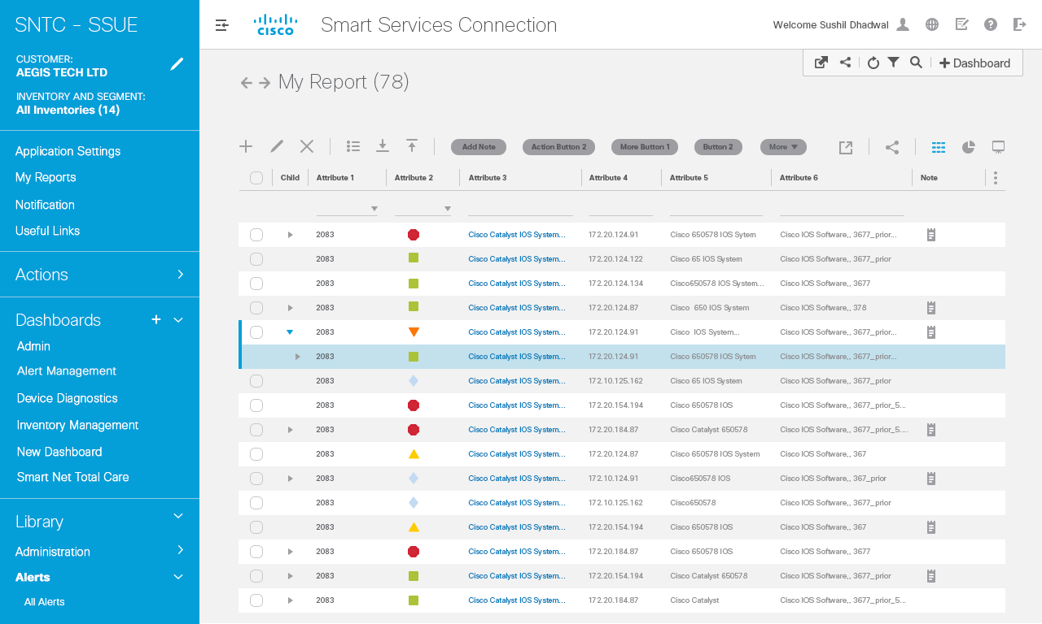
Interaction Notes
Parent--‐children Relationship
In Data Grid
Children Row component: By default, children and Grandchildren rows will be collapsed.
Child row collapse/expand
button: Upon click, expands to Show child rows
Number of child rows available Within the parent row
1
2
1
2

Slide 95
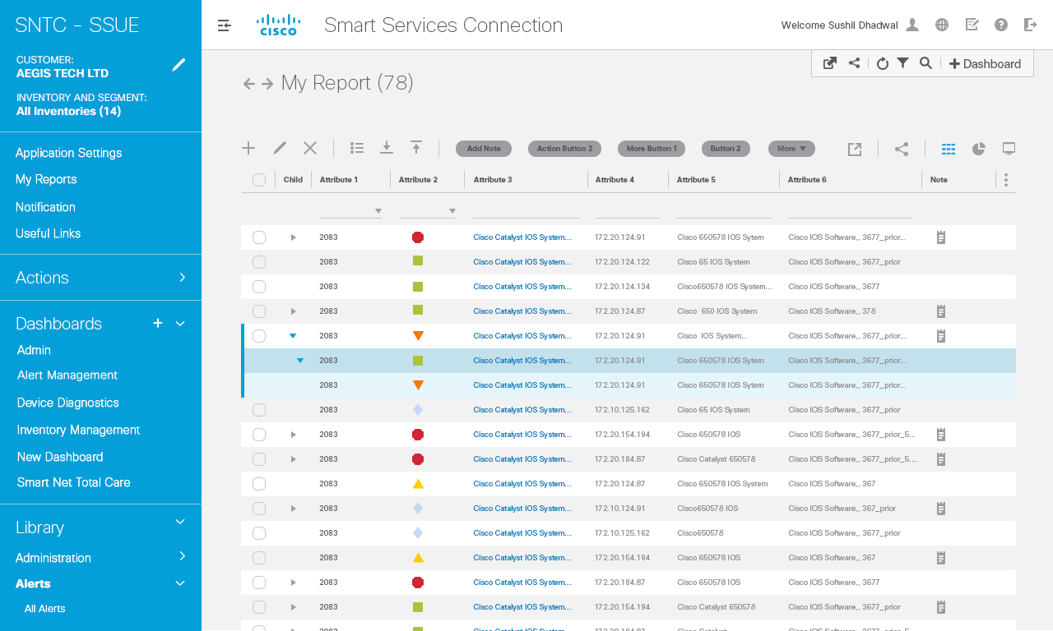
Interaction Notes
Parent--‐children Relationship
In Data Grid
Children/grandchildren rows
Will have different background
Color to separate from the rest
Of data grid rows.
1
1

Slide 96
Move Column

Slide 97
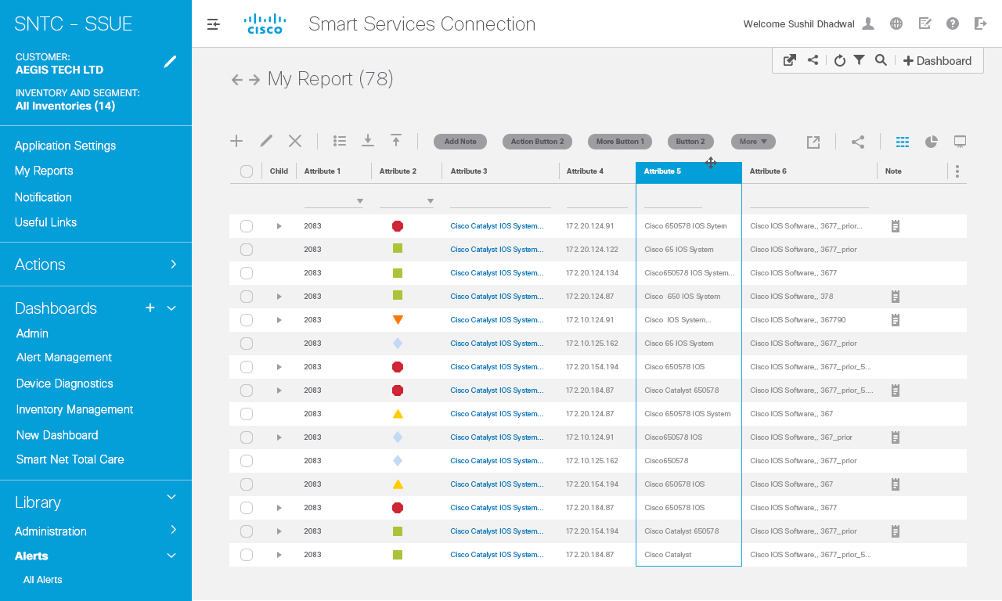
Interaction Notes

Slide 98

Interaction Notes

Slide 99

Interaction Notes

Slide 100
Thank You

